Slide 1





Mahatma Education Society’s
PILLAI UNIVERSITY
HackCelestial 3.0
01. Identification
Team Name:
03. Pitch Summary
Abstract:
WINNERS
Journi is a deterministic spatial itinerary engine engineered to eliminate fragmented planning, transit zig-zags, and LLM hallucinations. Built for complex urban transit ecosystems, Journi integrates PostGIS spatial pruning, 10-factor mathematical ranking, and a multimodal suburban rail graph to deliver optimized single-day journeys in under 50ms. By applying continuous vector geometry, it mathematically eliminates back-tracking while enforcing DPDP Act 2023 compliance via 500m spatial cloaking. Crucially, Journi decouples routing logic from language generation—using Gemini strictly for explainability—delivering a privacy-first, zero-hallucination platform that unifies local discovery with sustainable transit.
02. Focus Area
Problem Statement Title:
Local & Experiences — Intelligent Local Discovery & Experience Platform
1

Slide 2




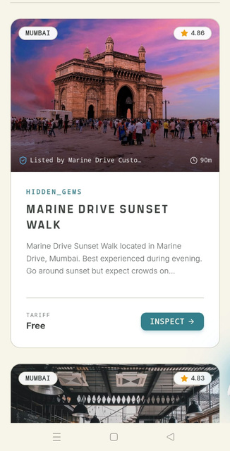

Proposed Solution
A smart travel platform that enables users to discover and choose sustainable, accessible and practical travel options based on their individual needs.
How It Addresses The Problem
Time & Convenience
Sustainability
Accessibility
Personalization
Budget
Promotes environmentally responsible travel choices.
Helps users find options that match their accessibility needs.
Balances travel time, comfort and convenience.
Tailors recommendations to each user’s individual requirements.
Recommends choices that fit the user’s budget.
2

Slide 3


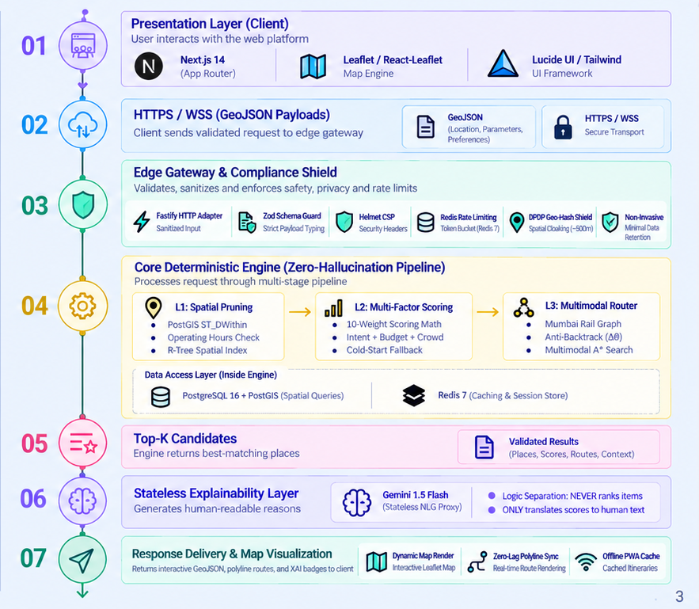
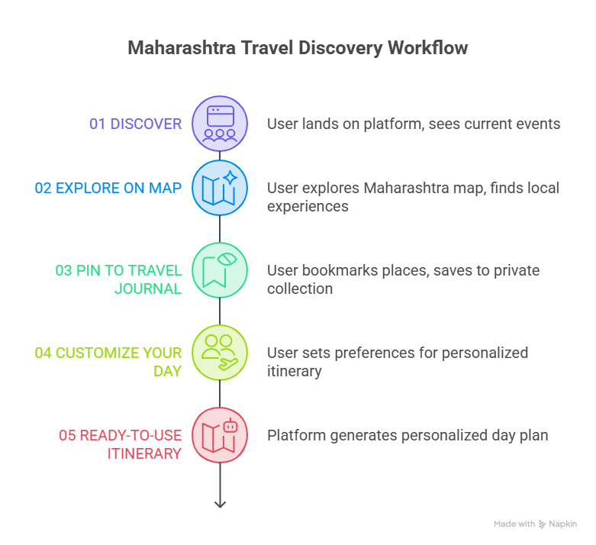

Flow Chart / Architecture
3

Slide 4



WHY WE ARE DIFFERENT
Not another travel app. A deterministic intelligence layer engineered for spatial logic and verifiable trust.
PILLAR 01
PILLAR 02
PILLAR 03
Anti-BackTrack Intelligence
Deterministic AI Architecture
Privacy-First local Discovery
Generic Planner Fails spatial Efficiency.We Eliminate zig-zag navigation via vector math
ZERO HALLUCINATION RANKING
DPDP ACT 2023 COMPLAINT
Ranking is a math problem, not an LLM guess. Our engine separates logic from language.
Eliminating the trade-off between personalization and privacy via spatial hashing.
Haversine + Compass Bearing (Δθ)
PostGIS + 10-Factor Scoring
Spatial Transformation
Continuity=1−Δθ/180
Top-K Deterministic Extraction
Raw GPS Coordinates ❌
↓
~500m Spatial Hash ✅
Colaba → Bandra → Colaba ❌
Colaba → Bandra → Juhu ✅
LLM Explainable Phrasing
No Persistent GPS Tracking
Coarse Recommendation Shield
1.0
<5Oms
100%
ROUTE CONTINUITY SCORE
DETERMINISTIC RANKING LATENCY
COMPLIANCE INTEGRITY
“AI doesn't decide where you go. Mathematics does. AI only explains why.”
OUR UNFAIR ADVANTAGE
Spatial Intelligence + Route Continuity + Explainable AI + Privacy

Slide 5
Technical Details
THREE ENGINE PIPELINE
TechStack:
ANTI-BACKTRACK CONTINUITY
Next.js 14 (App Router), TS, Tailwind
1
L1 - PostGIS Hard-Filter
Frontend:
ST_DWithin radius + open-hours + accessibility tags. O(N). 0ms overhead.
Δθ = |θtravel − θcand| (mod 360)
Geospatial/3D:
Leaflet, React-Leaflet, Three.js
Backend:
NestJS (Node/TS), Fastify adapter
S = α e⁻ᵇΔθ + β d/(1 + Δt)
2
L2 – 10-Factor Scoring
α = angle · 1.0 β = turn · 0.5 Δt = turn · 0.0
Database:
PostgreSQL 16 + PostGIS, Prisma ORM
Weighted sum → score ∈ [0,1]. Intent 0.25, rejection 0.25, location 0.20 dominate.
TOP SCORING WEIGHTS
Cache:
Redis 7 – rate limit, session, geo bounds
Intent match
0.25
Rejection penalty
Gemini – stateless, read-only phrasing
0.25
XAI proxy:
3
L3 – Multimodal A*
Location match
0.20
Real-road routing + Mumbai rail graph. Walk → Train → Walk, fare in INR.
Security:
Helmet CSP, Trusted Types, DOMPurify, Zod
Budget Fit
0.15
Rating
0.15
5

Slide 6




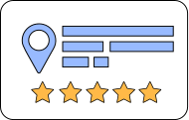














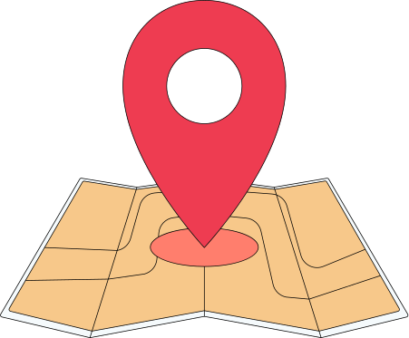
Existing Solutions and The Gap
Great Platforms Exist - But The Journey Is Fragmented
Today’s Landscape
THE GAP
OUR EDGE
Google Maps:Places and Navigation
OUR PLATFORM
Limitations: Limited experience personalization
TripAdvisor:Reviews & Attractions
SEARCH
REVIEWS
Search
Personalize
Plan
Experience
Limitation:Primarily Review-Centric Discovery
Airbnb Experiences:Local Activities
Personalized Discovery
Limitation:Limited Coverage of the Broader Local Ecosytem
INSPIRATION
Local and Hidden Experiences
Social Media: Travel Inspiration
Context Aware Recommendations
Limitation:Unstructured content and difficult planning
BOOKING
PLAN
End to End Experience Planning
Local Guides:Authentic Recommendations
THE GAP
Limitations:Fragmented and difficult to access at scale
Users Switch Across Multiple Platforms to Build One Complete Experience
ONE PLATFORM.ONE JOURNEY

Slide 7



Supplementary Information (Optional)
Demo Video Link
Live Website Link
Drive Link:
Github Link :
https://github.com/BigSmokeweb/Experience-Platform.git
https://drive.google.com/drive/folders/1hWAMkA09VcqYzZ9ma5LkXpD_hoi2D99L?usp=sharing
Website Link :
https://experience-platform-sigma.vercel.app/
Youtube Link:
https://www.youtube.com/watch?v=junkQDvLp18
7

